Slide 1


Exposure CS 2020
for CS1
Chapter 3 Section 3-4 Slides
Introduction to Python Coding:
Output with print & Comments
PowerPoint Presentation
created by:
Mr. John L. M. Schram
and Mr. Leon Schram
Authors of Exposure
Computer Science

Slide 2
Section 3.3
Text Output
With print

Slide 3
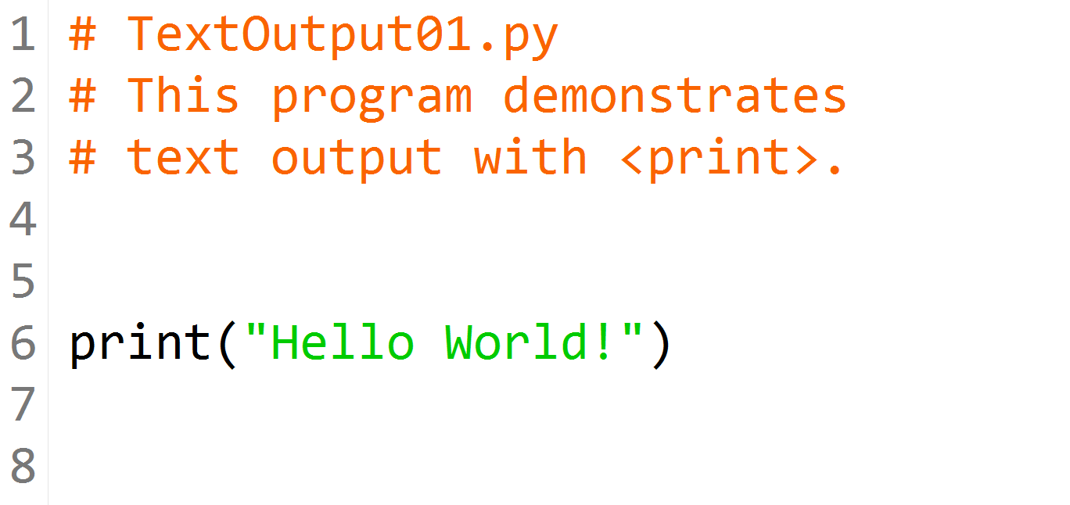
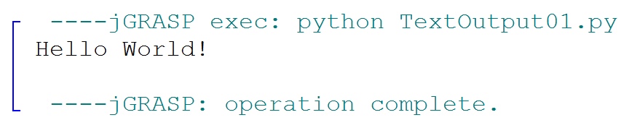

Slide 4
Python Keywords & Program Statements
A Python keyword is a word that has a special meaning in a program or performs a special function.
A program statement usually contains one or more keywords.
Keywords in Python are case-sensitive.
For example:
print is a Python keyword, while PRINT is not.

Slide 5
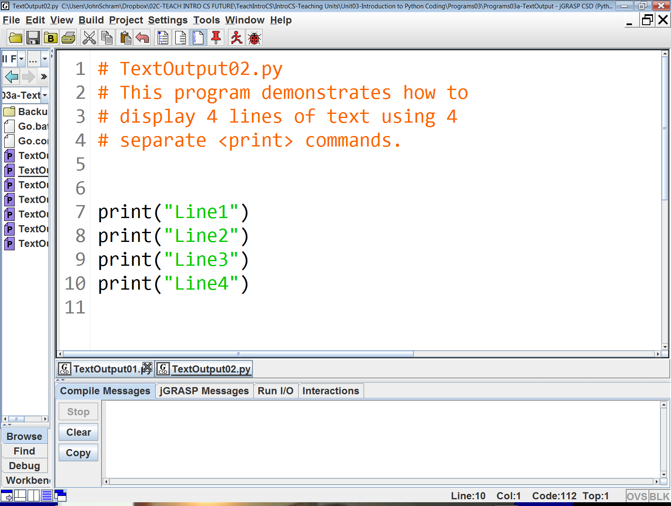
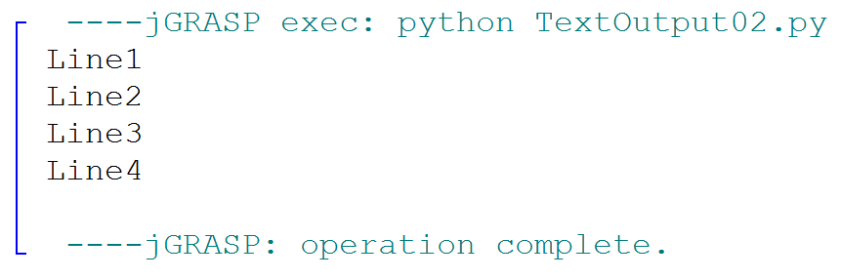

Slide 6
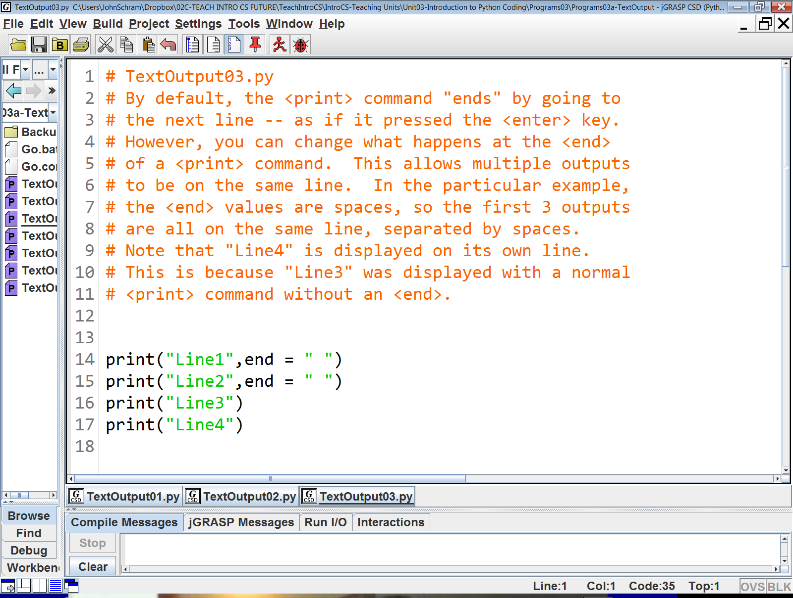
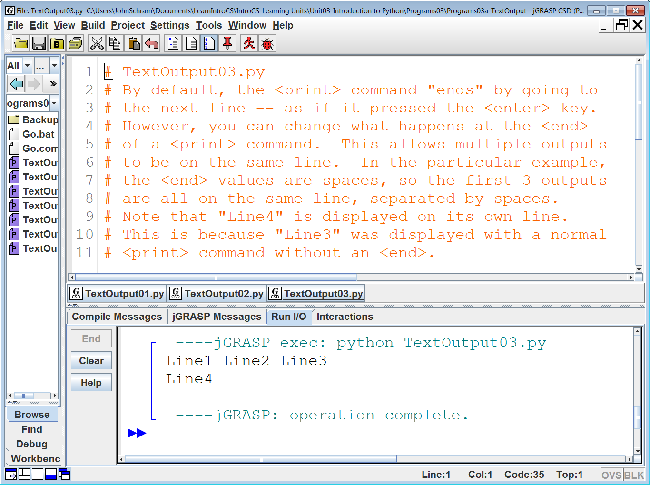

Slide 7
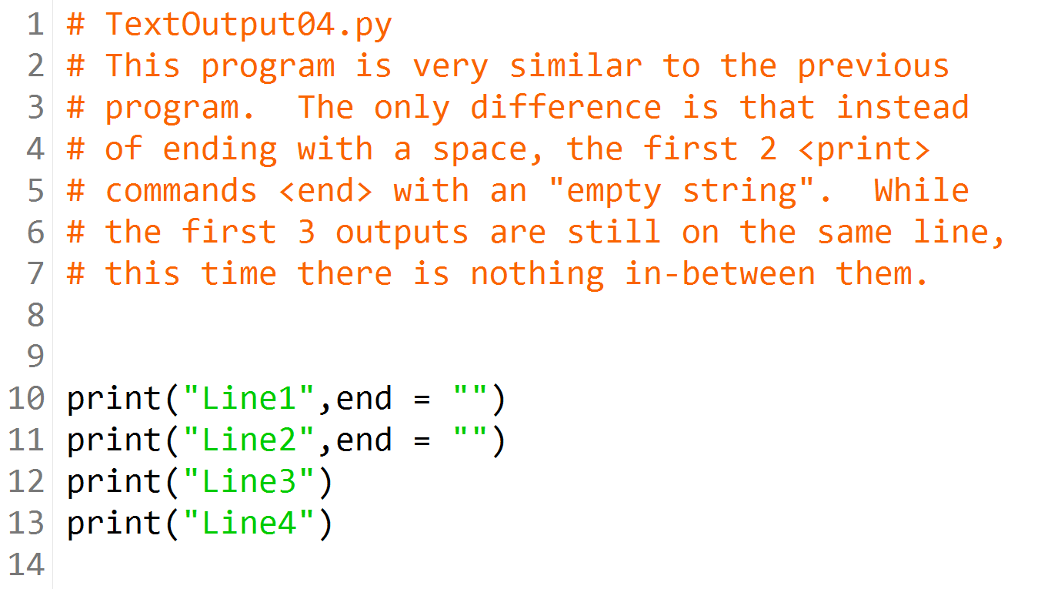
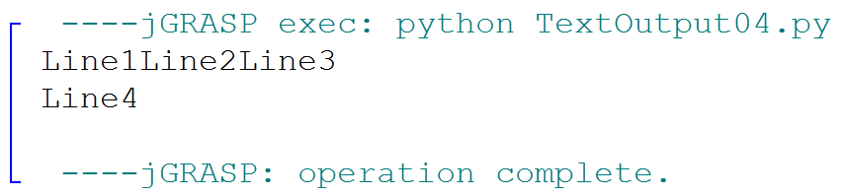

Slide 8
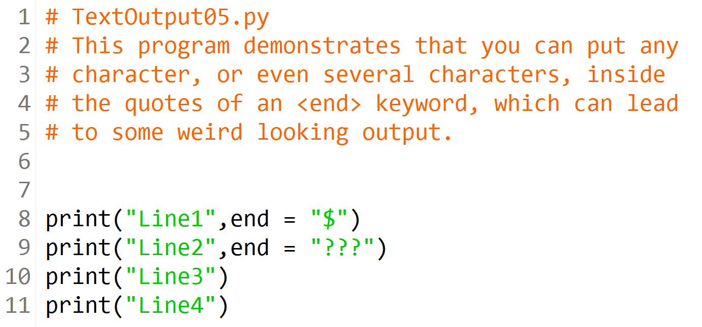
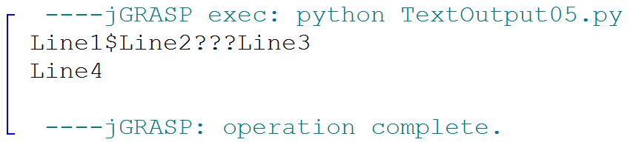

Slide 9
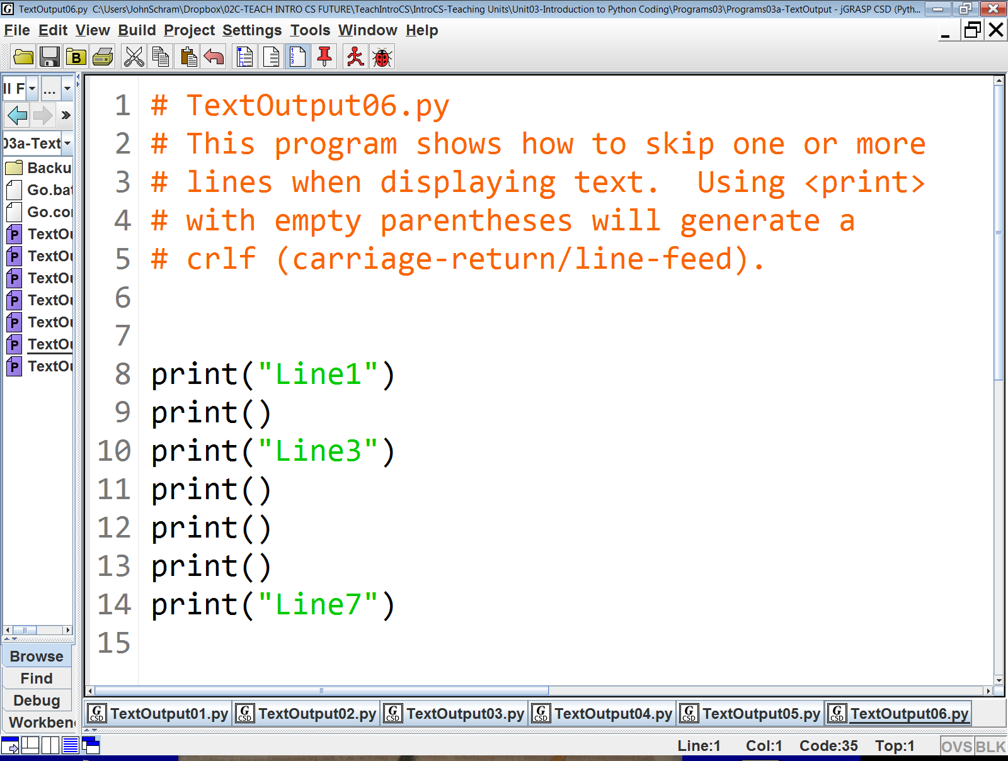
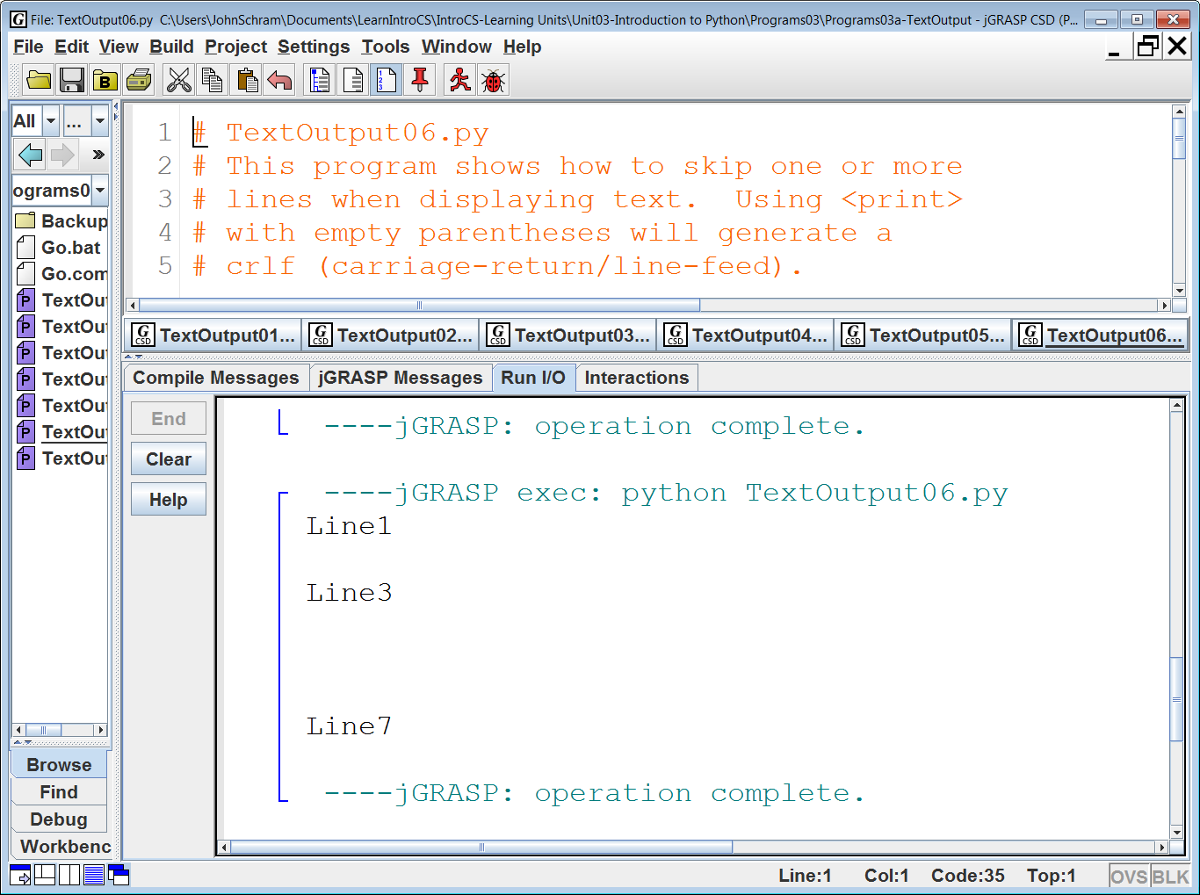

Slide 10
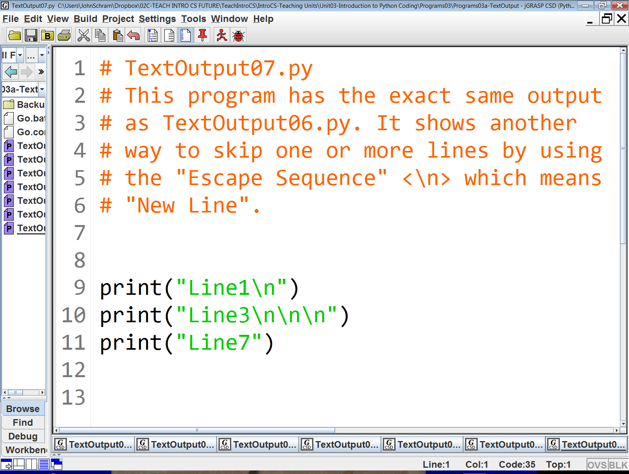

Slide 11
print & end
The print command generates an output display of the characters contained between double quotes.
If the end keyword is not used, print will also generate a carriage-return/line-feed (crlf).
If the end keyword is used, print will not generate a crlf and instead display the specified text in the second set of quotes.
Examples:
print("Hello") print("World") will display: Hello World | print("Hello", end = " ") print("World") will display: Hello World

Slide 12
Creating Blank Lines
Creating a blank line of output can be done 2 different ways.
One is to use print() with absolutely nothing in the parentheses.
The other is to add the \n Escape Sequence to an existing print statement:
Examples:
print("Hello") print() print("World") will display: Hello World | print("Hello\n") print("World") will also display: Hello World

Slide 13
Section 3.4
Program
Comments

Slide 14
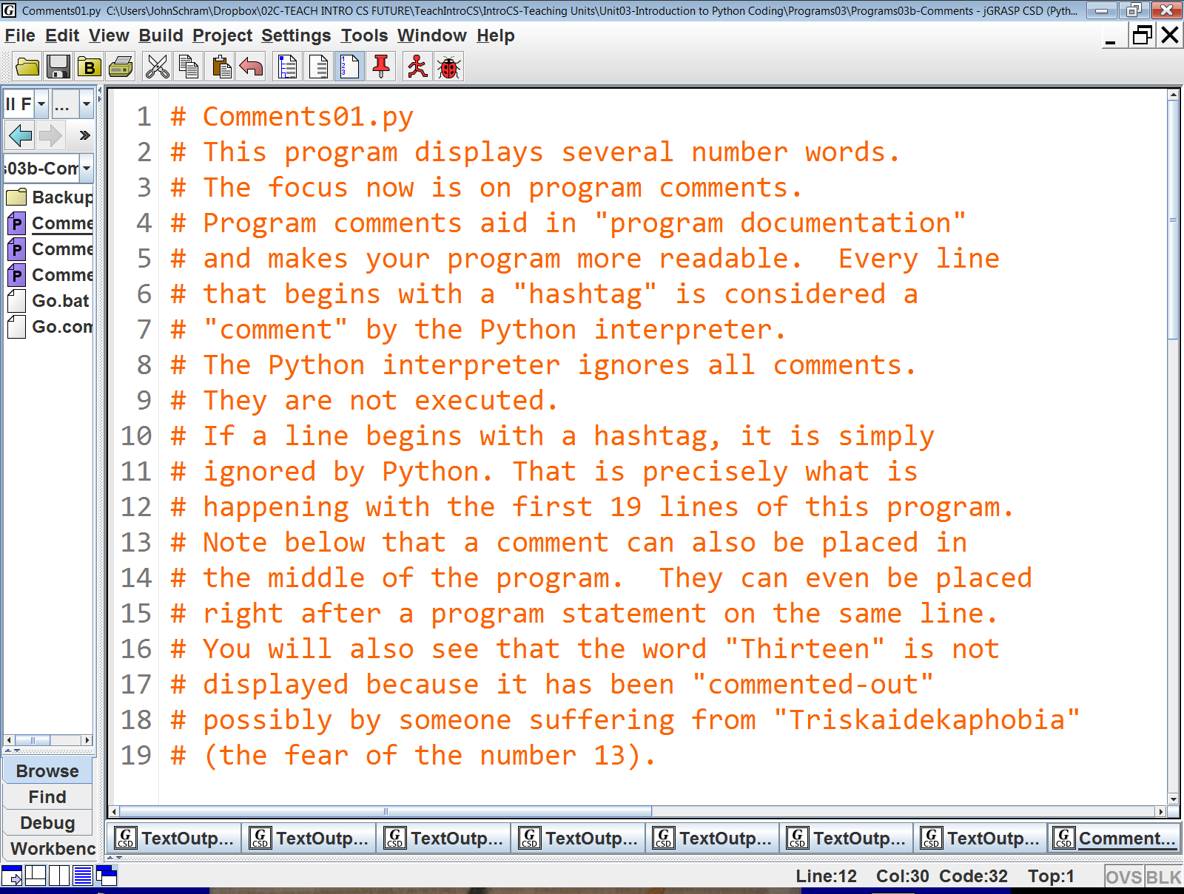

Slide 15
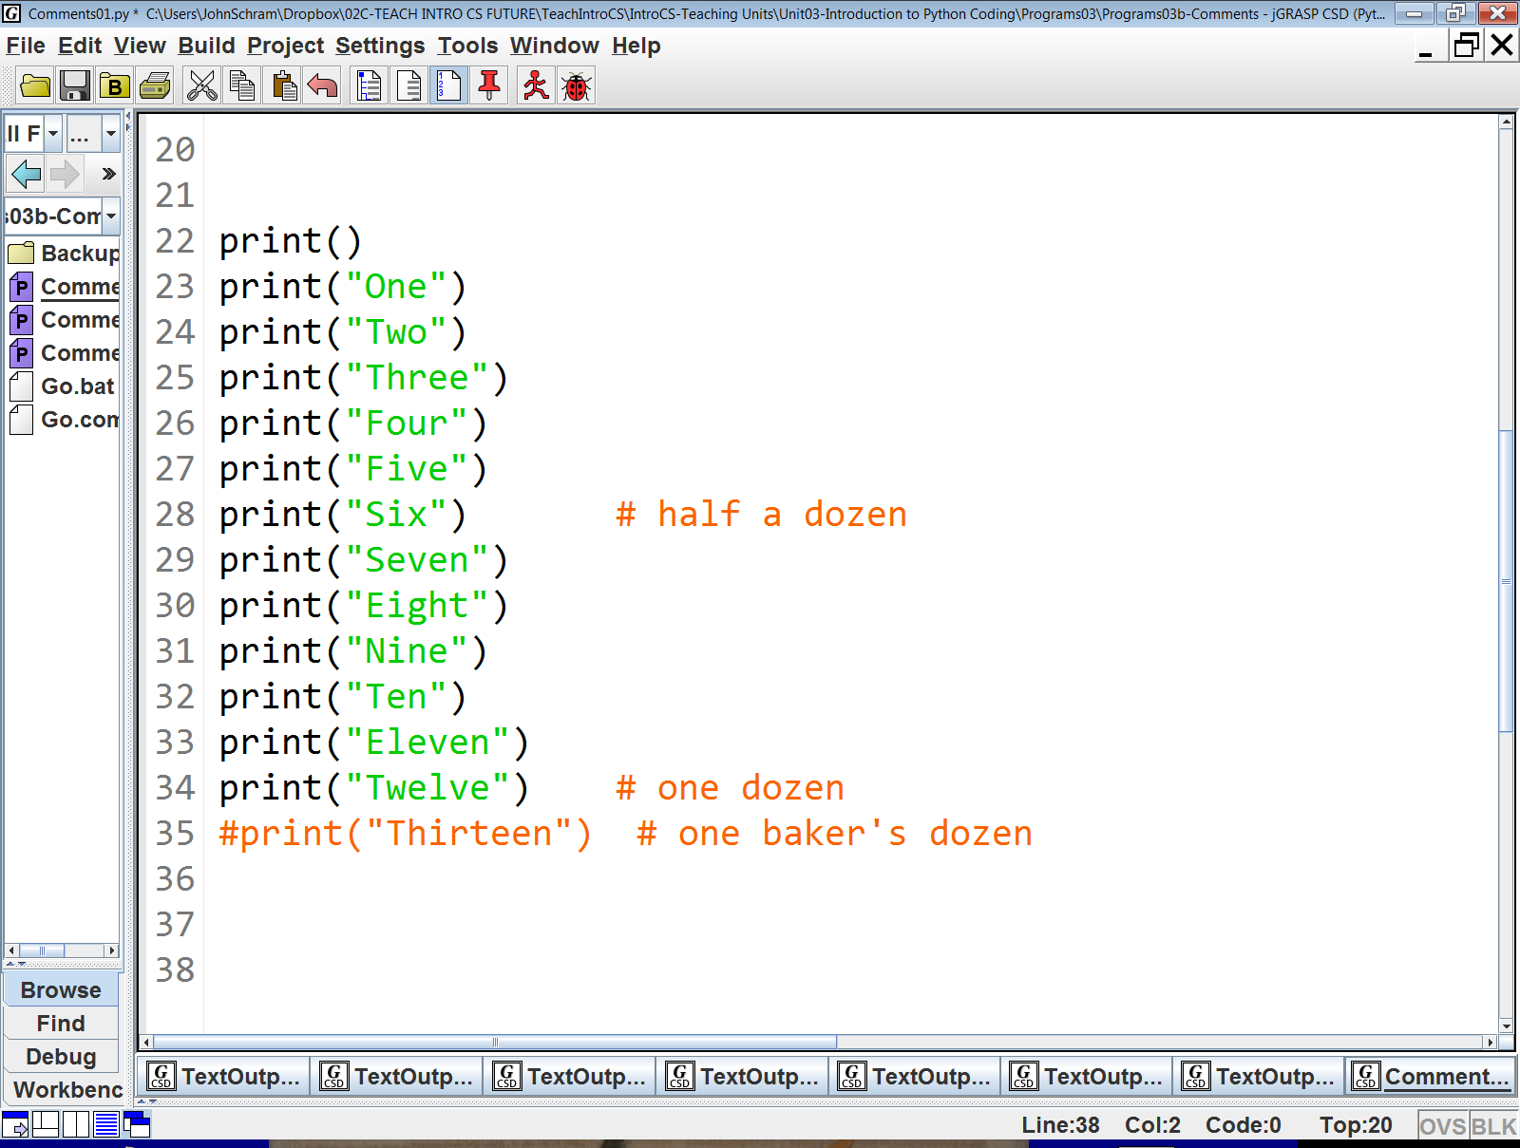

Slide 16
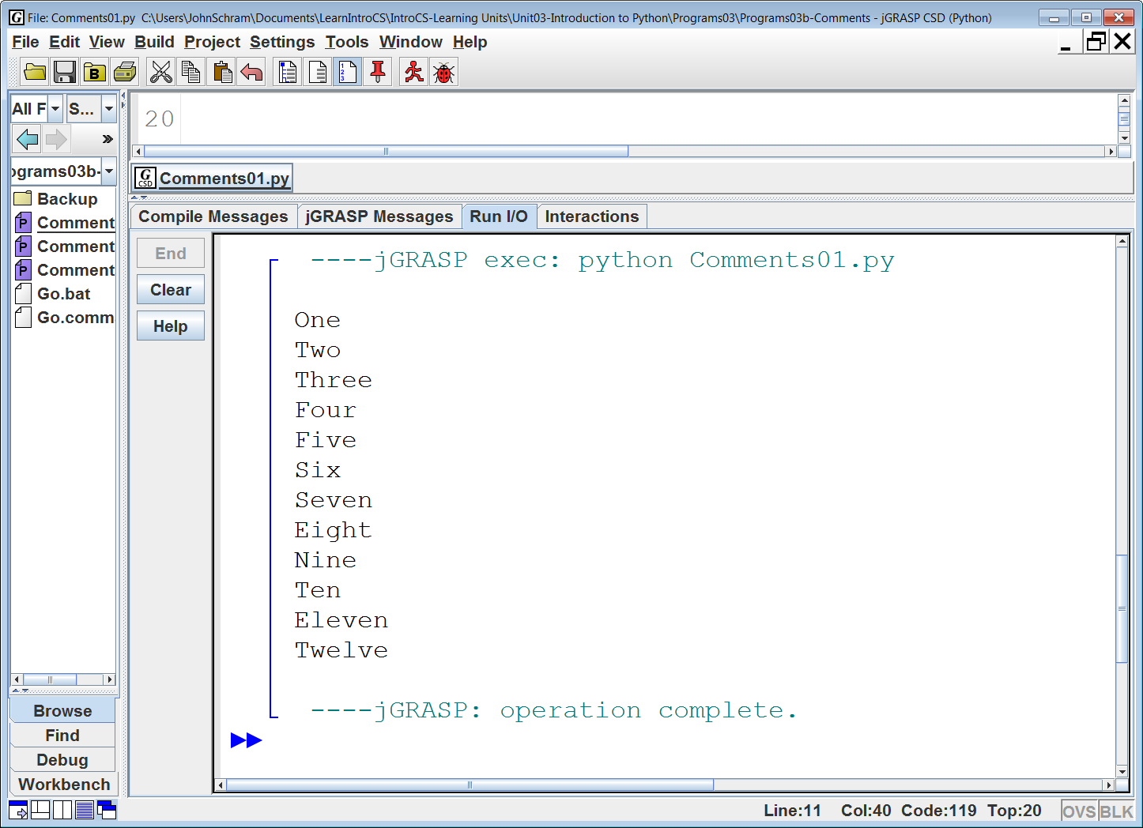

Slide 17
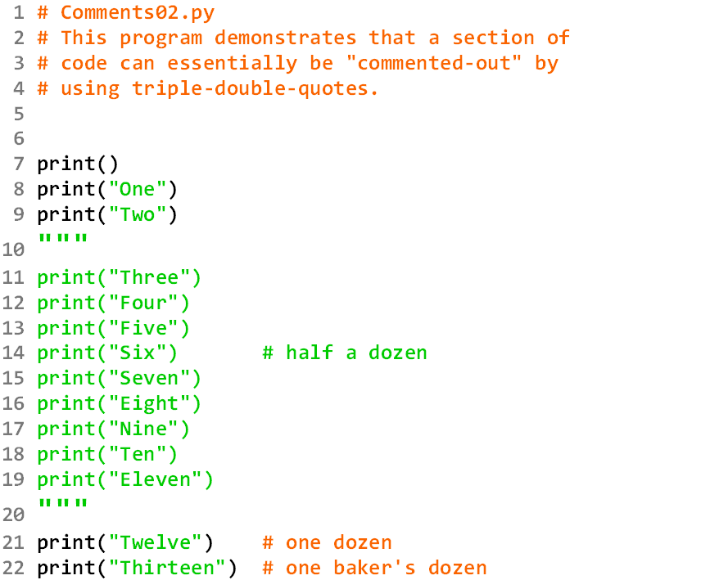
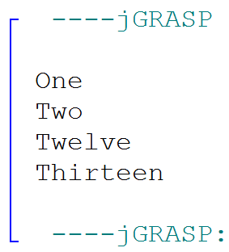

Slide 18
String Literal Definition
A string literal is any text in-between a set of quotes.
The “text” can be a name, letter, group of words, or basically anything that you can type inside a set of quotes.
Examples:
"computer"
"John Smith"
"Hello all you happy people."
"Q"
"?"
"811 Fleming Trail"
"Richardson, Texas"
"75081"
Most print statements contain a string literal in their parentheses.

Slide 19

Python Multi-Line Comment Disclaimer
Technically, Python does not have Multi-Line Comments.
The “Triple-Double-Quote” is actually used to create a
multi-line string literal.
This is why they are green and not red like the Single-Line Comments.
However, multi-line string literals which are not part of a print statement are simply ignored by the Python interpreter.
This essentially makes them multi-line comments.

Slide 20
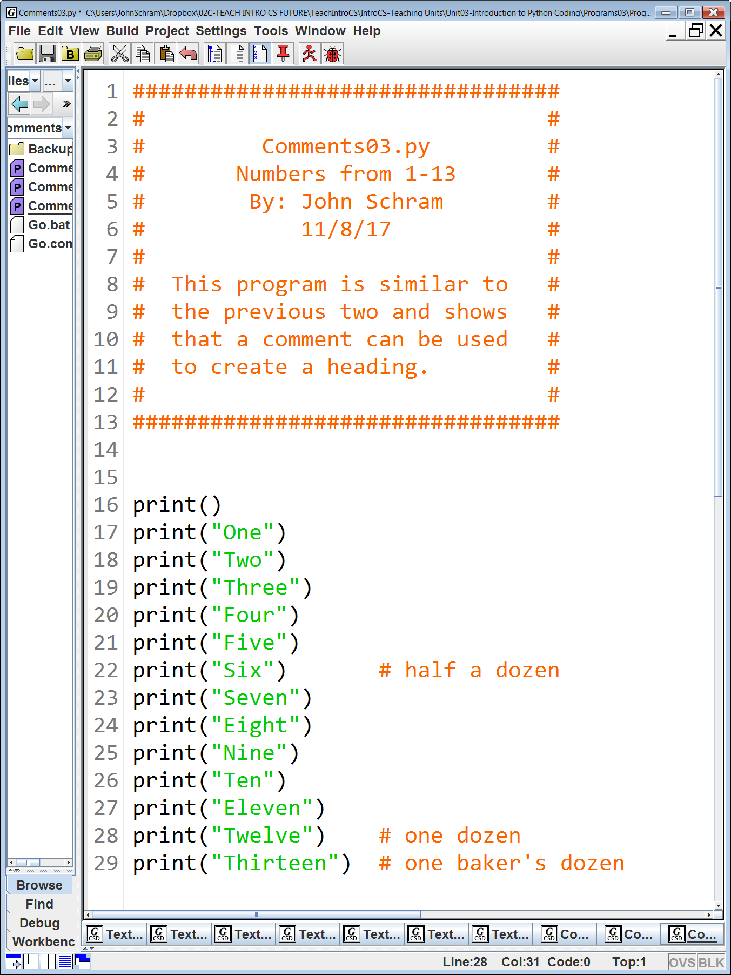
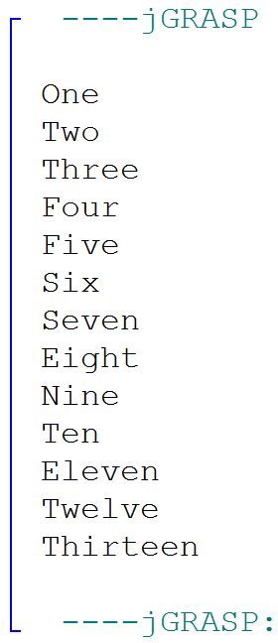

Slide 21
2 Different Types of Comments
# This is a single-line comment.
print("Good morning!") # So is this.
"""
This is a
multi-line
comment.
"""

